Slide 1



Miami Property Prices Have Been Rising Nonstop

Slide 2
MDC Property Value Analysis
Population &
Demographics
Economics
Sales Analysis
Tax Implication
Buyer’s origin
Type of sales
Interest rates
Leading Indicators

Slide 3
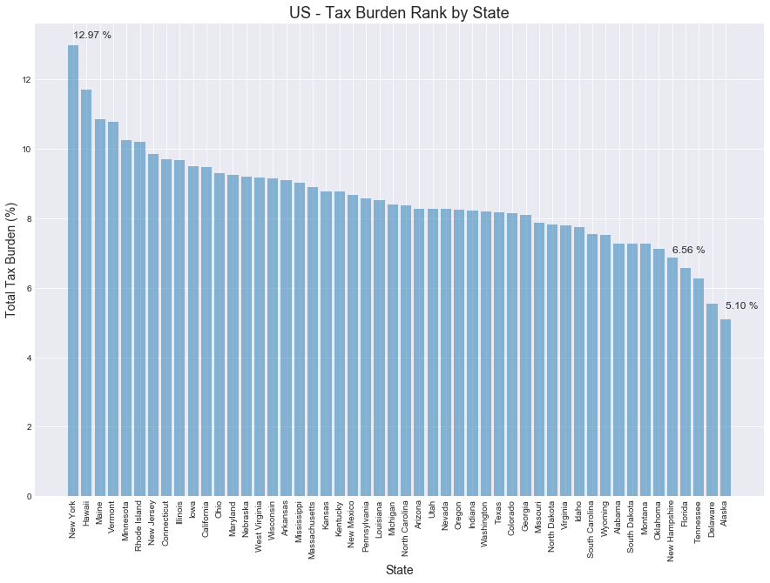
Interest from high earners in tax-burdened states continue to drive demand in the South Florida real state market

Slide 4
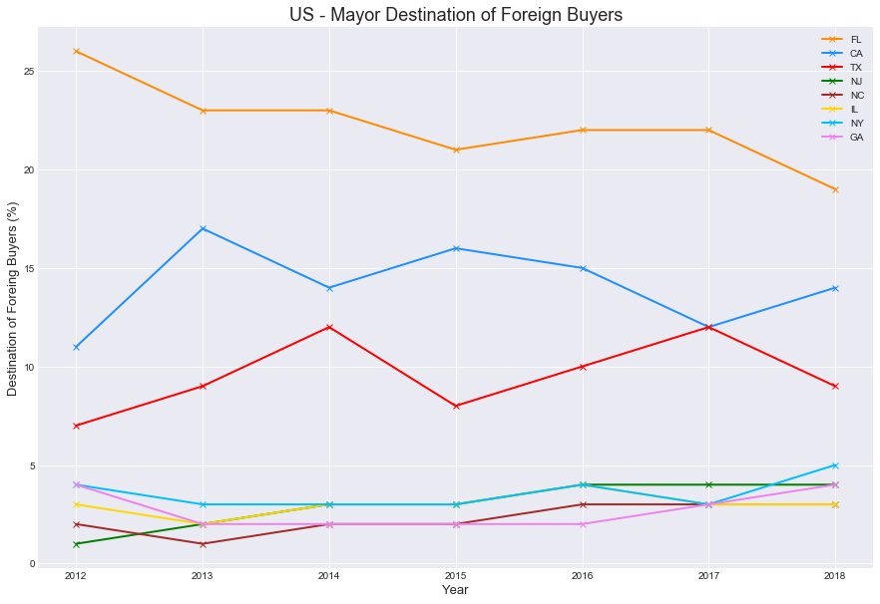
Florida have been the top destination, accounting for 22 percent in average of foreign buyer purchases.

Slide 5
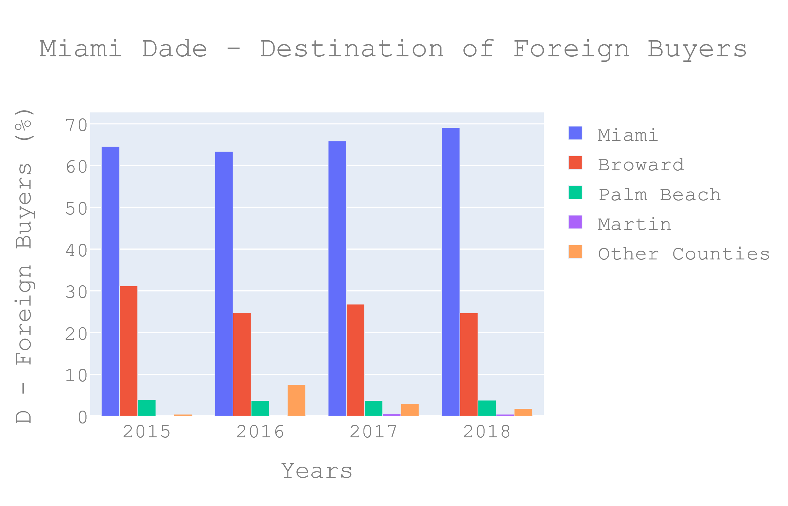
Miami Dade County have been the top destination, above 60% percent of foreign buyer purchases.

Slide 6
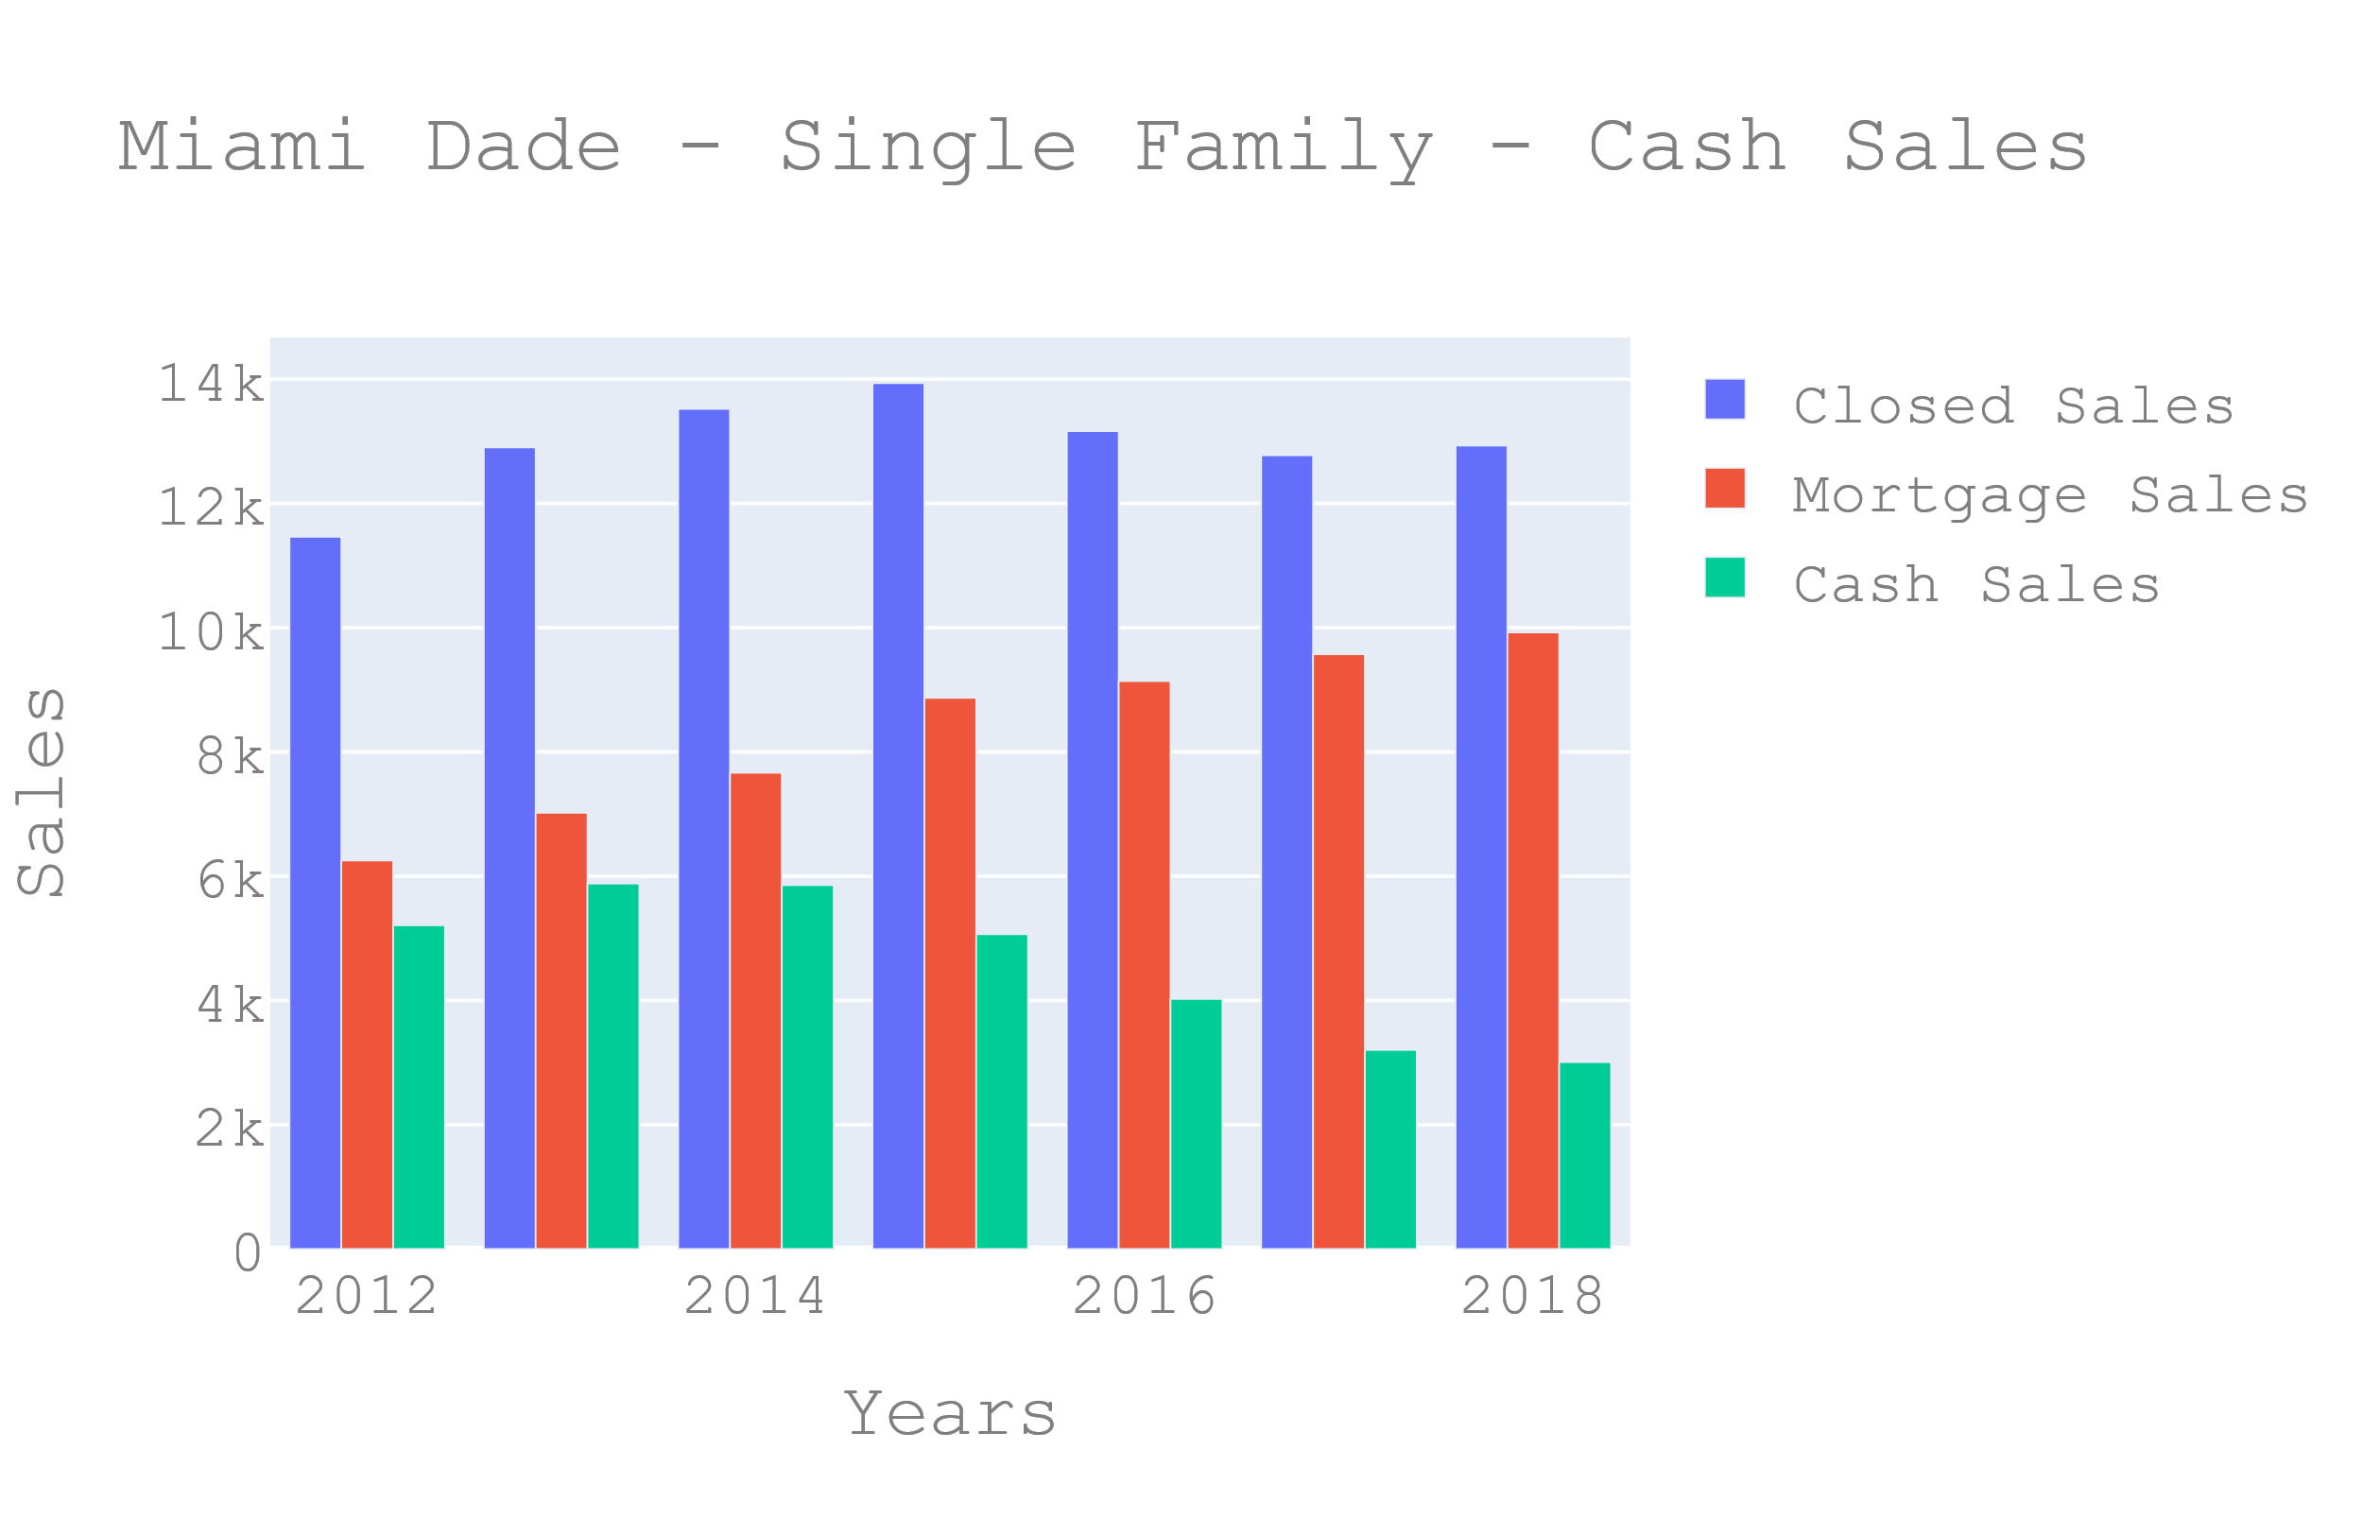
Cash sales in Miami have been higher than the national average of about 16% reflecting Miami’s popularity with international home buyers, and investors who tend to purchase properties in all cash

Slide 7
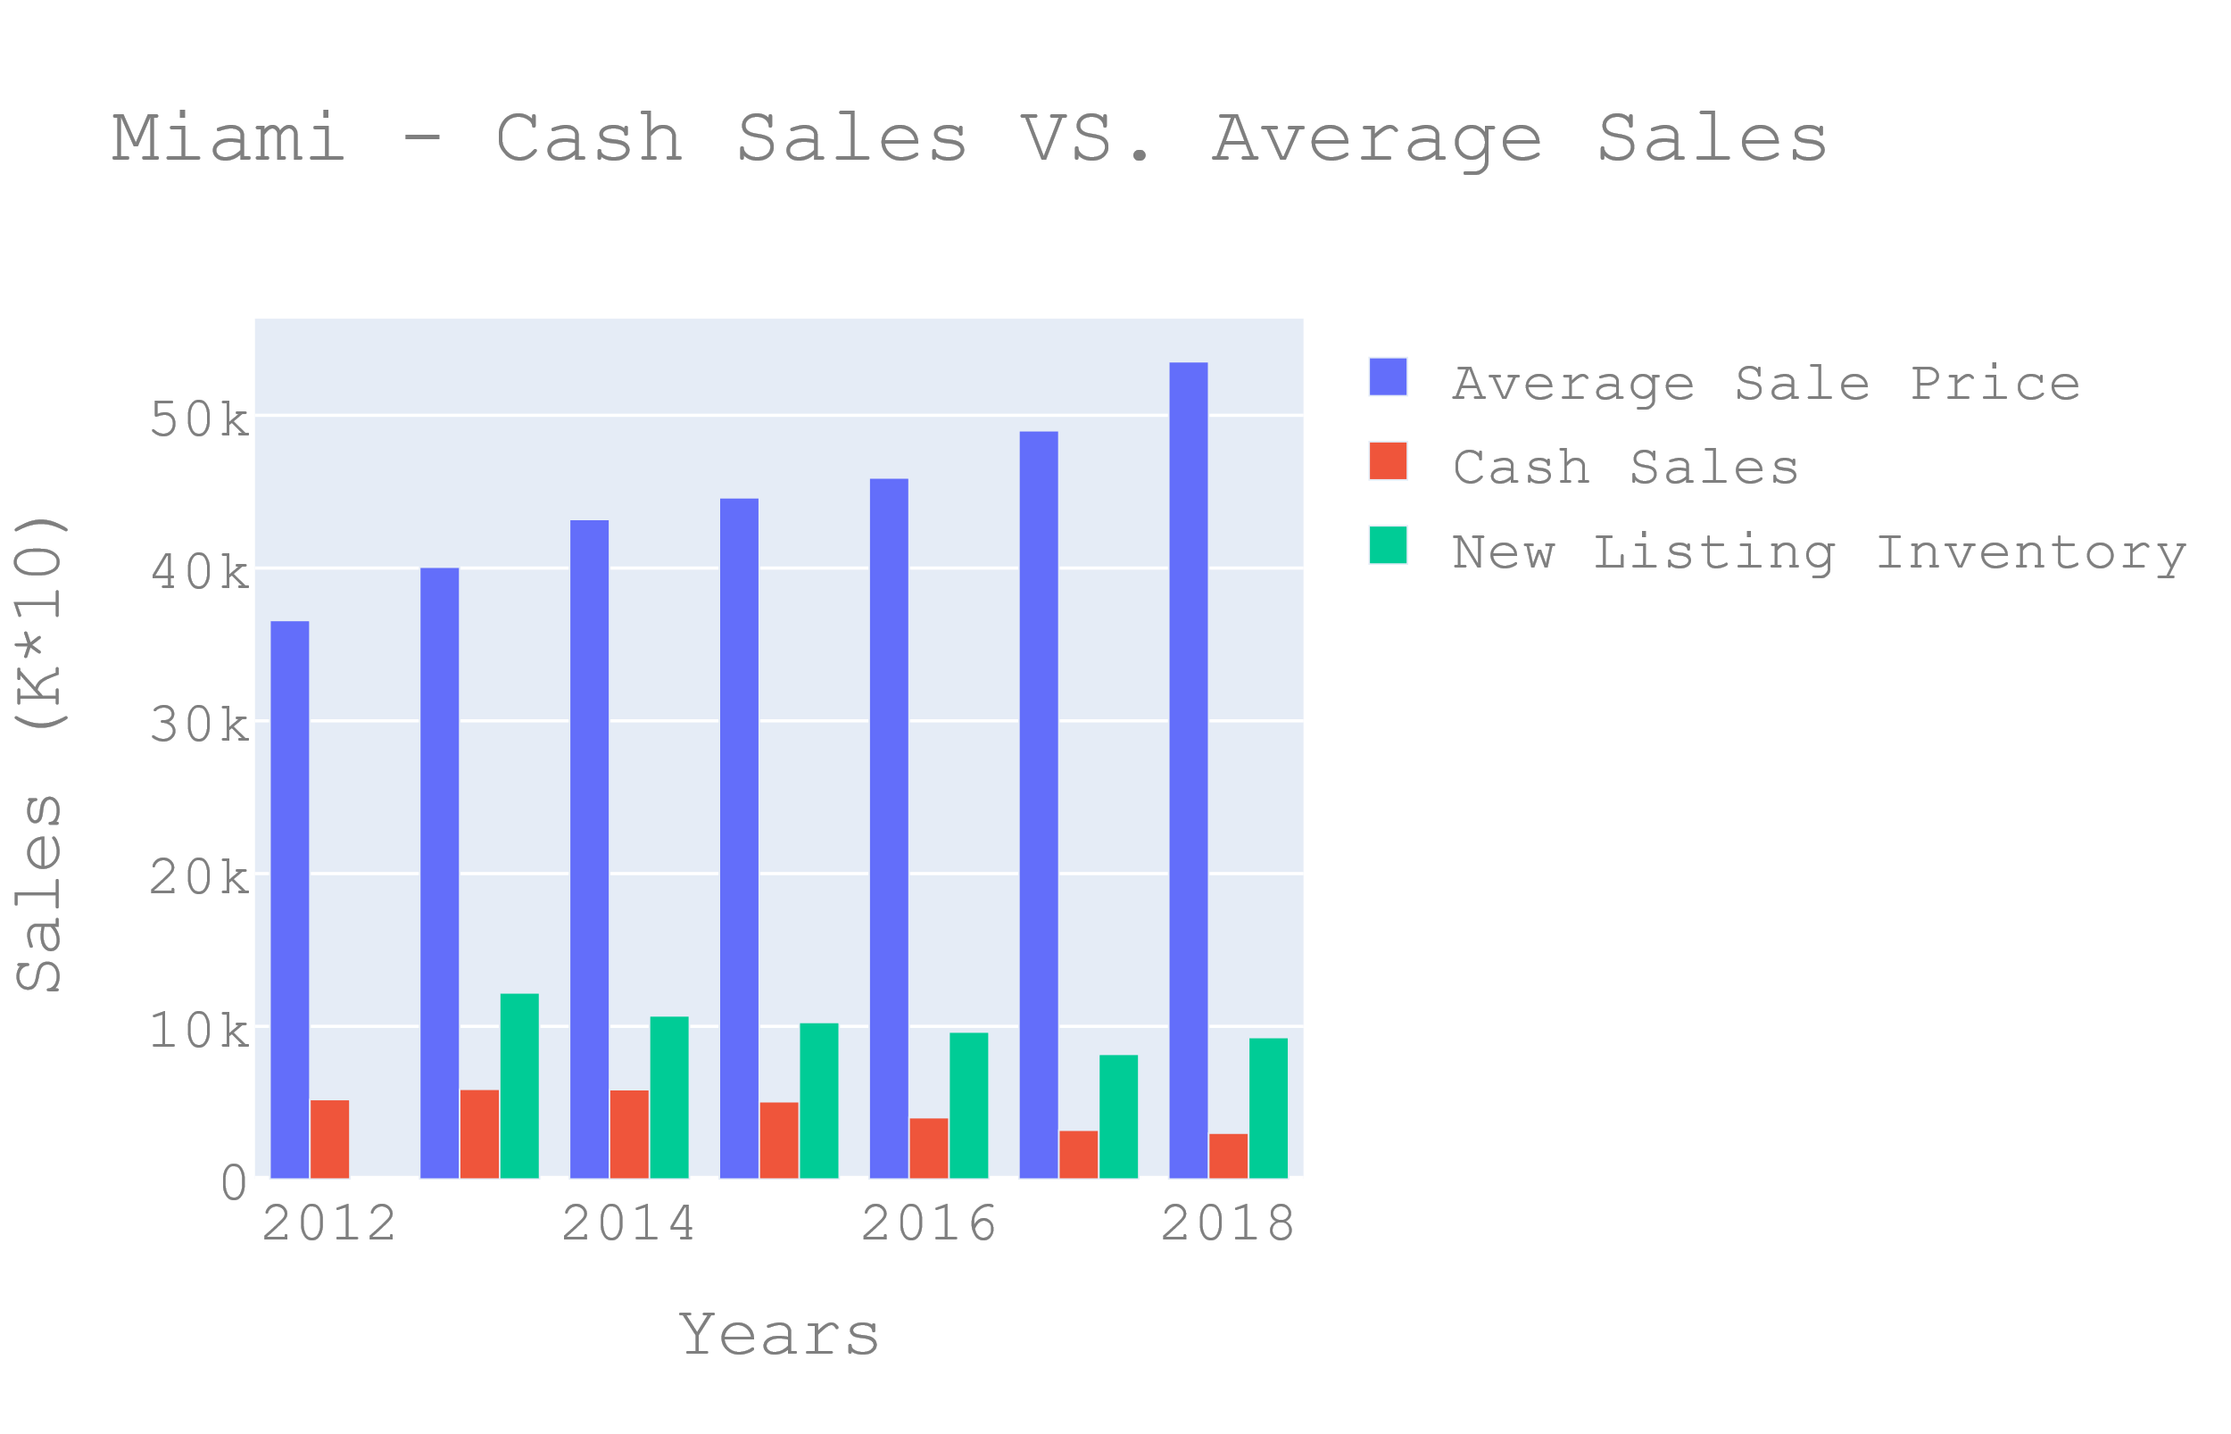
Even though there is decrease in the cash sales in Miami, the average sale price have been consistently rising due to a decrease in new listing inventory.

Slide 8
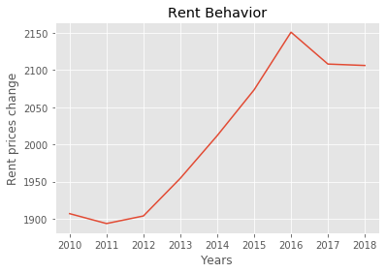
Interest Rate for the past 5 years
Even though interest rates for the 30yr home mortgages have been near-historic lows. There is a fairly medium correlation between the low rates and the increase in the average home prices in MDC. Therefore it can be concluded that the increase in home value prices are attributed to other factors.

Slide 9
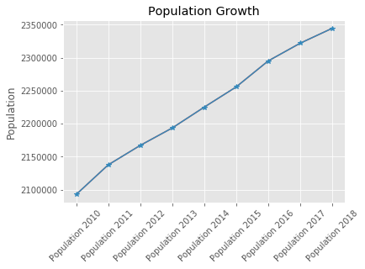
Interest Rate for the past 5 years
Even though interest rates for the 30yr home mortgages have been near-historic lows. There is a fairly medium correlation between the low rates and the increase in the average home prices in MDC. Therefore it can be concluded that the increase in home value prices are attributed to other factors.

Slide 10
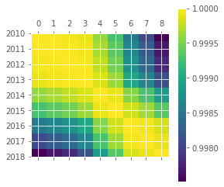
Interest Rate for the past 5 years
Even though interest rates for the 30yr home mortgages have been near-historic lows. There is a fairly medium correlation between the low rates and the increase in the average home prices in MDC. Therefore it can be concluded that the increase in home value prices are attributed to other factors.

Slide 11
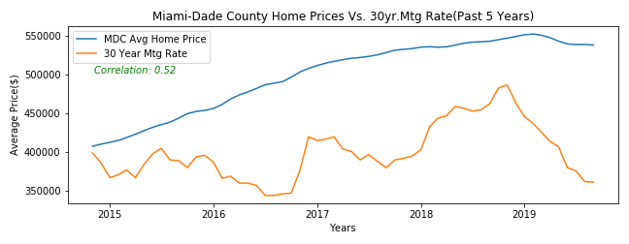
Interest Rate for the past 5 years
Even though interest rates for the 30yr home mortgages have been near-historic lows. There is a fairly medium correlation between the low rates and the increase in the average home prices in MDC. Therefore it can be concluded that the increase in home value prices are attributed to other factors.

Slide 12
Leading Economic Indicators
The most relevant leading indicators of our economy that influence home market values are employment data. When employment is strong there is more power of acquisition and also drives up the consumer confidence which accounts to two thirds of our economy. Another important indicator is the manufacturing activity since manufacturing is a key indicator since developers require manufacturers to produce more materials to build. Government policies and subsidies is also another factor in properties. Tax credits, deductions and subsidies are some of the ways the government can temporarily boost demand for real estate. Being aware of current government incentives can help you determine changes in supply and demand and identify potentially false trends.

Slide 13
Data Sources: https://www.zillow.com/research/data/ https://www.miamirealtors.com/ https://www.nar.realtor/ https://www.data.gov/

